Slide 1
Project 4
Can we predict salary and job title of a position?
Angie Sheng
26/08/2019

Slide 2
1. Raw Data
2. Data Cleaning
Seek.com.au
Columns =['Salary Range', 'Link', 'Job Title', 'Job Teaser', 'Advertiser', 'Classification', 'Location', 'Strong Words', 'Job Description', 'Category']
Data Scientist
Data Analyst
Data Engineer
BI Analyst
Salary Range =[‘0-70k’,’70k-120k’,’over 120k’]
Last scraped on 21/08/2019

Slide 3
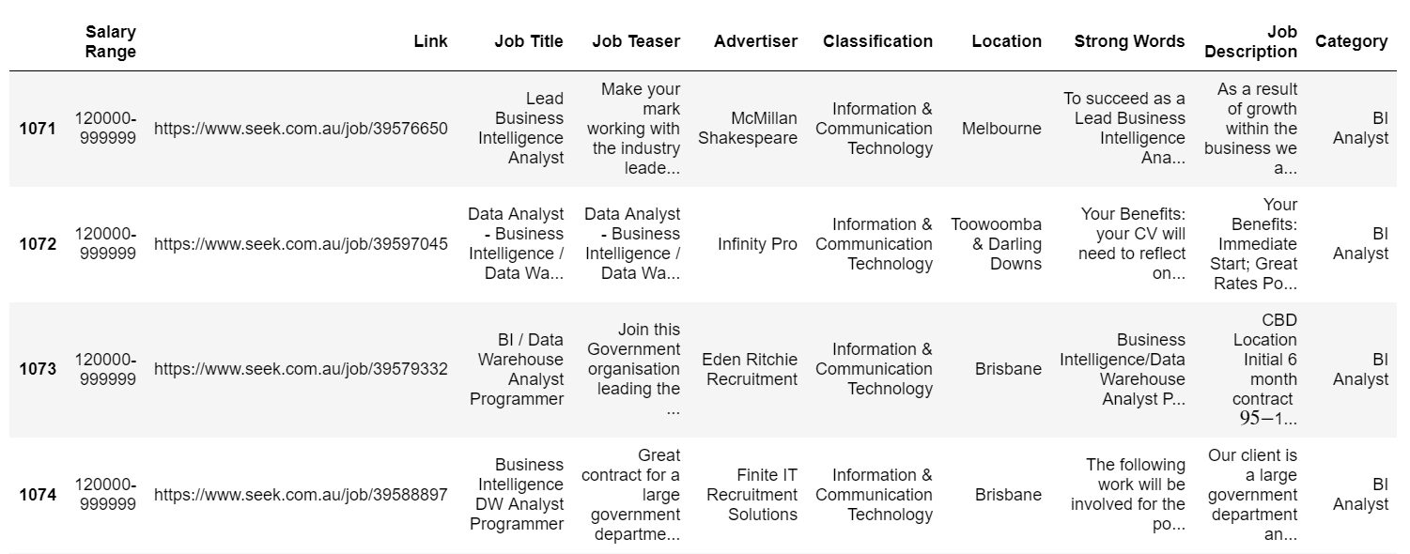
A Glimpse at the Data Set

Slide 4
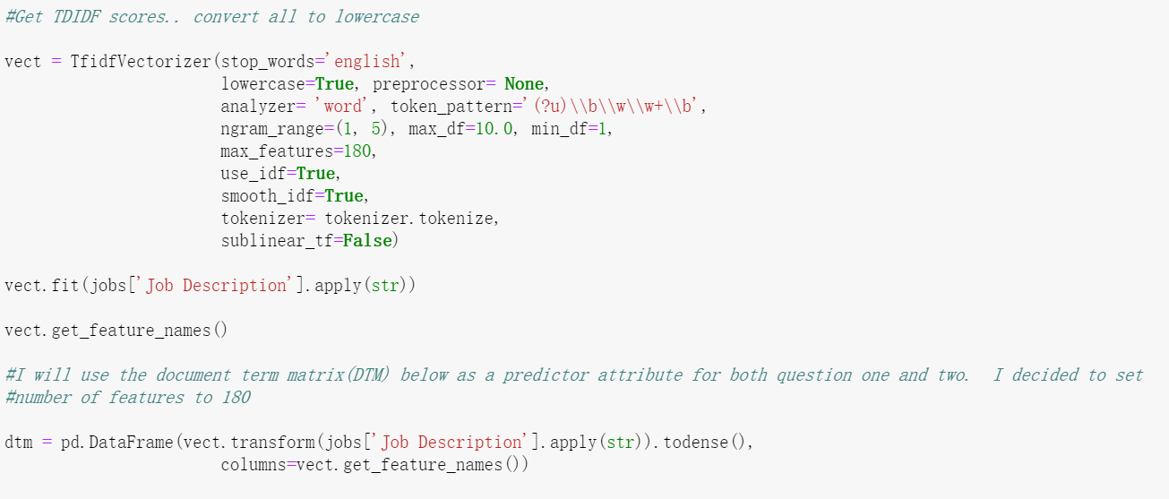
Question 1 What factors decided Salary
Get TD-IDF Score
Convert it to Document Term Matrix(DTM)

Slide 5
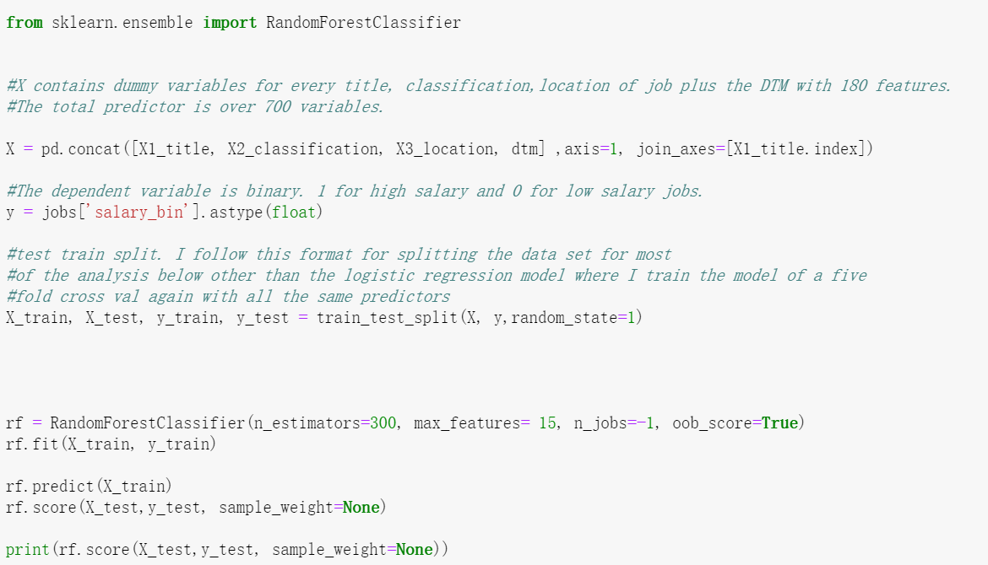
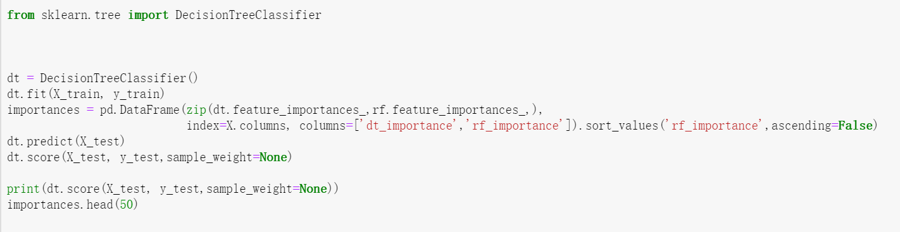
Question 1
Dummy Variables:
Job Title (Data Scientist, Data Analyst…)
Classification(IT, HealthCare…)
Location(Sydney, Melbourne…)
DTM
Classifier
Random Forest Classifier
Decision Tree Classifier

Slide 6
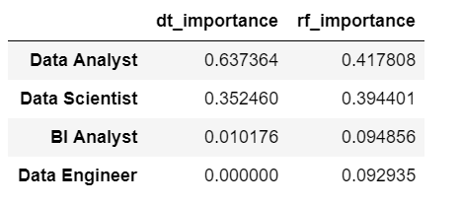
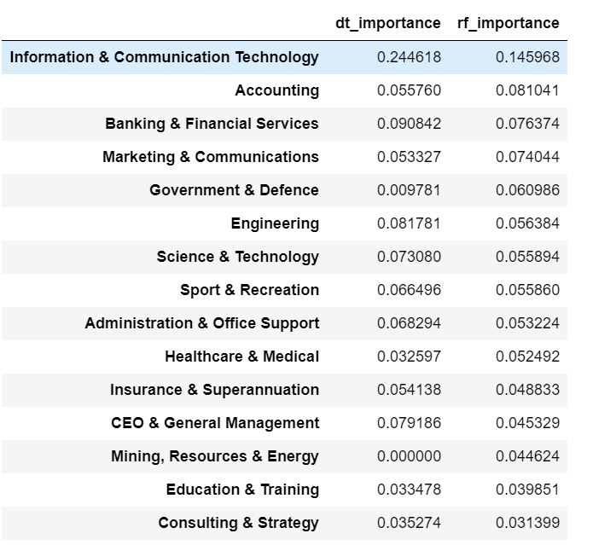
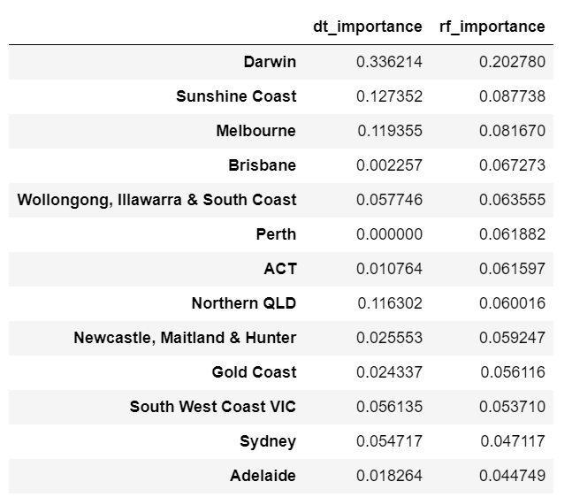
Accuracy: around 50%-60%
Question 1
Classification
Title*
* May due to unbalanced data set
Location*

Slide 7
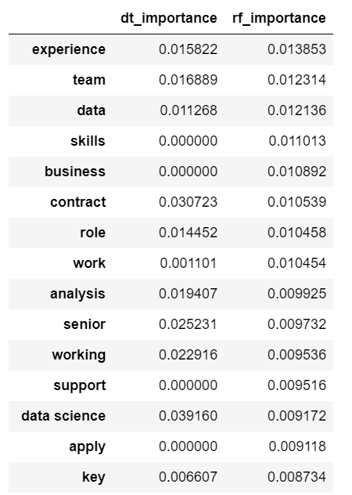
Question 1
Experience
Team Work
Data manipulation
Job Description
(DTM)

Slide 8
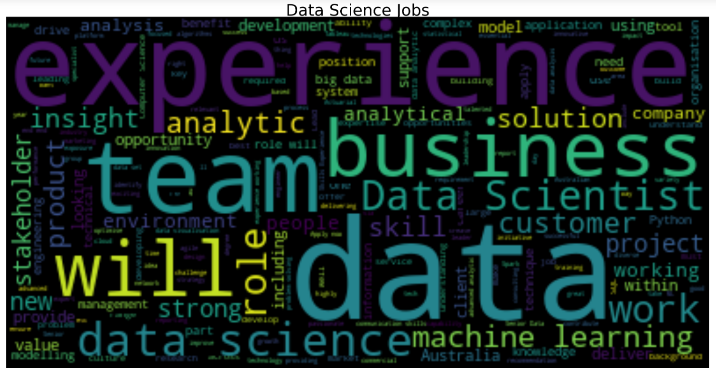
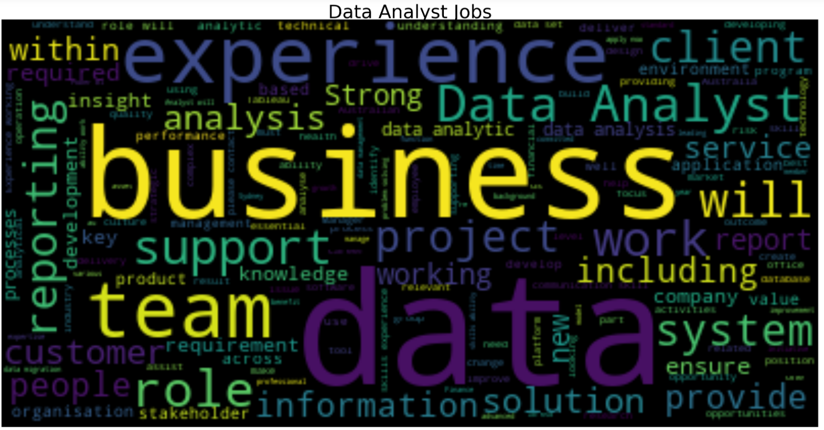
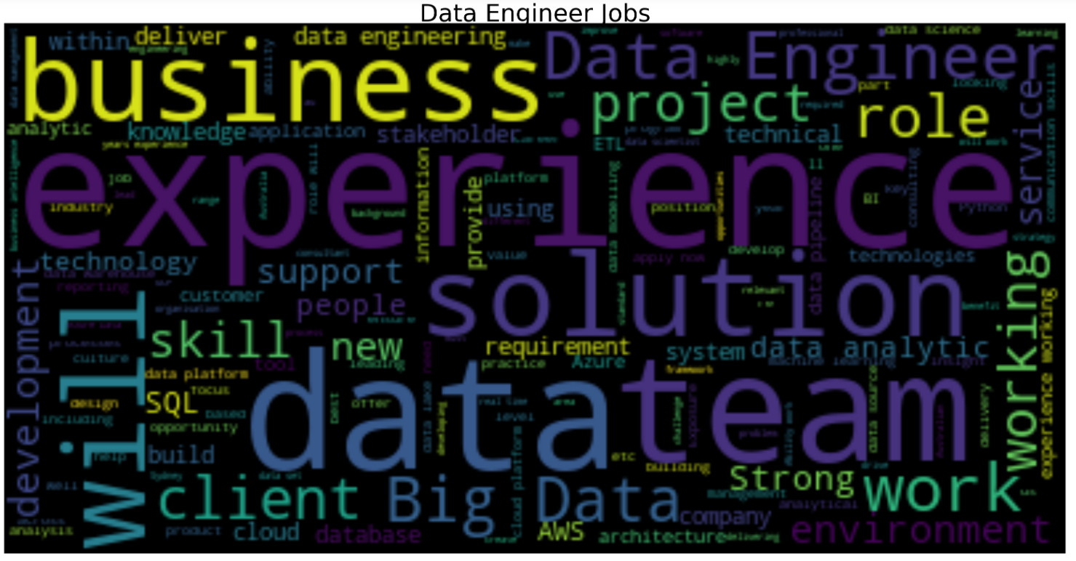
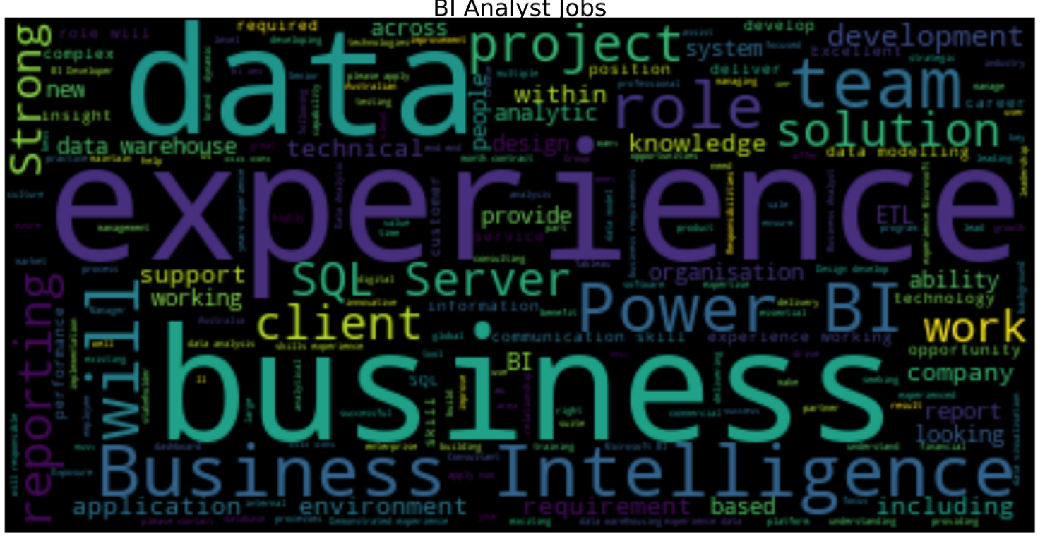
Question 2 what distinguish different job classifications? ----- 1) Word Cloud

Slide 9
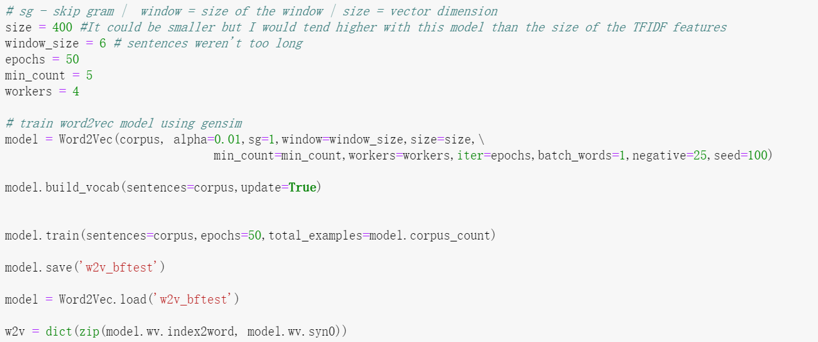
Question 2 what distinguish different job classifications? ------ 2) Word2Vec

Slide 10
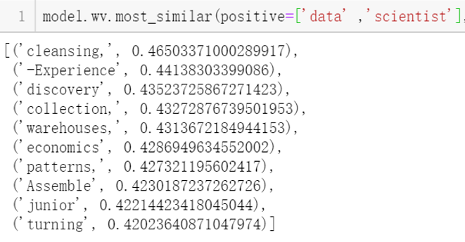
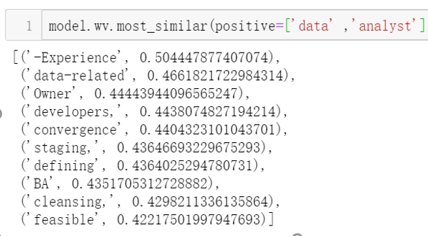
Question 2 what distinguish different job classifications? ------ 2) Word2Vec

Slide 11
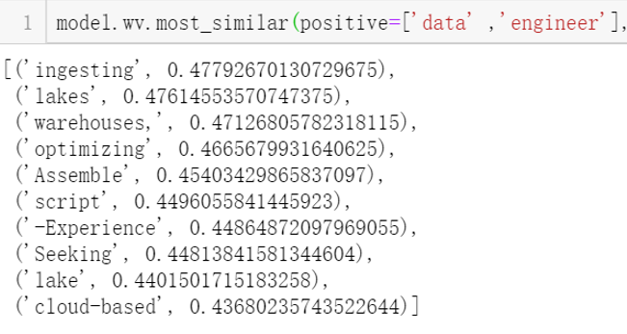
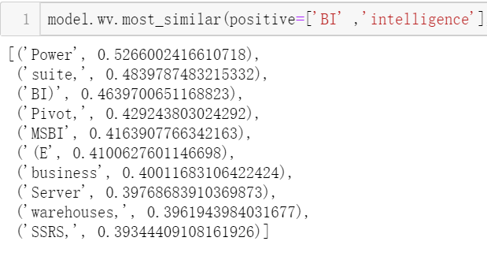
Question 2 what distinguish different job classifications? ------ 2) Word2Vec

Slide 12
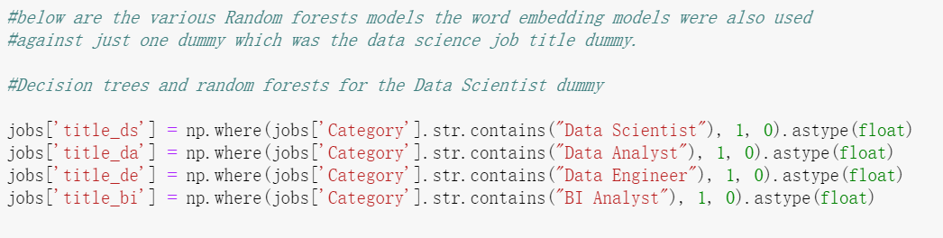
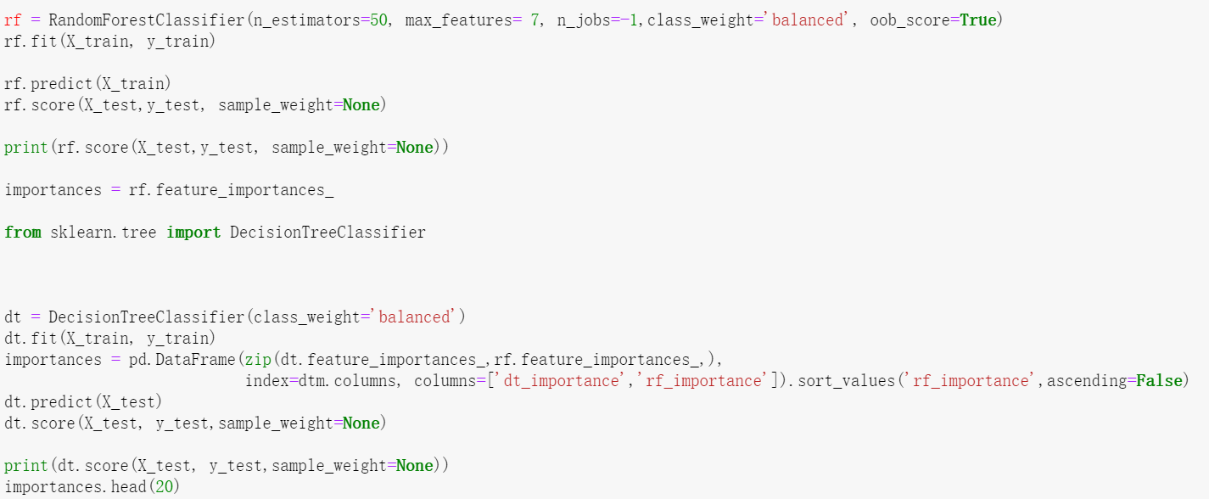
Question 2 what distinguish different job classifications? ---- 3) Random Forest & Decision Tree
TFIDF Score
Document Term Matrix(DTM)

Slide 13
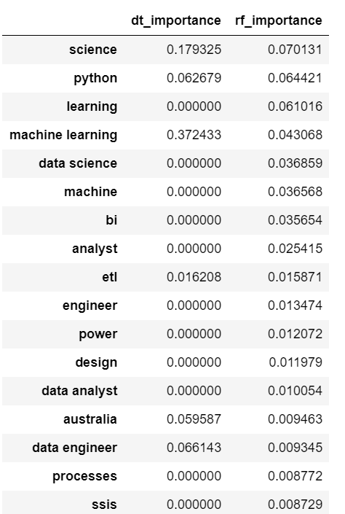
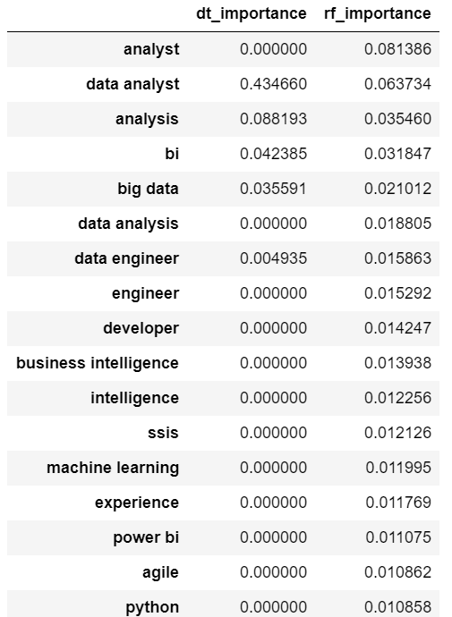
Question 2 what distinguish different job classifications? ---- 3) Random Forest & Decision Tree
Data Scientist and Data Analyst has different requirement towards python
Data Scientist
Data
Analyst

Slide 14
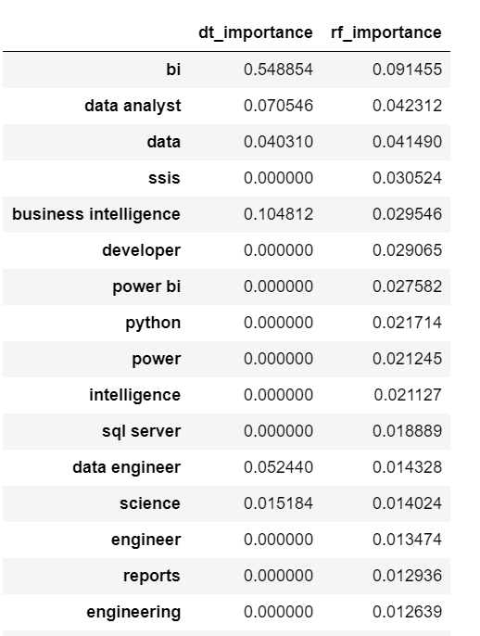
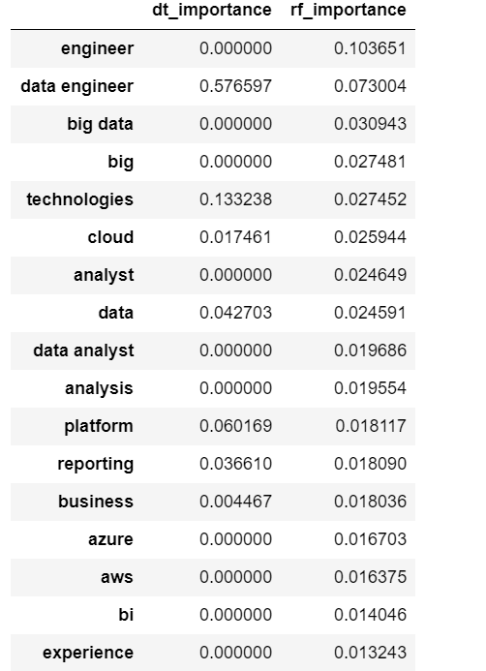
Question 2 what distinguish different job classifications? ---- 3) Random Forest & Decision Tree
Data Engineer
BI Analyst
Requirements on different skill sets

Slide 15
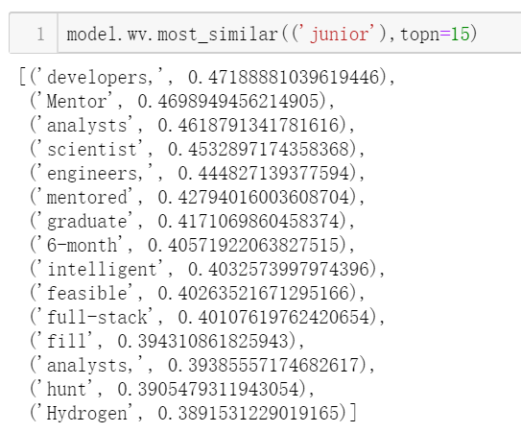
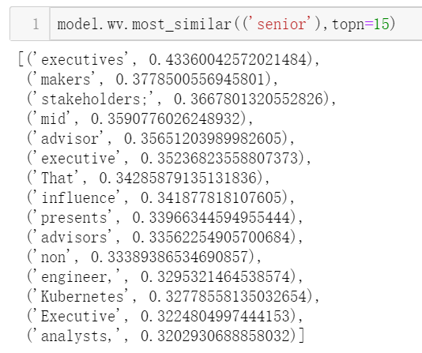
Question 2 what distinguish junior and senior jobs?
Hard skills
Soft skills

Slide 16
Insights
Experience is the most important part that employee will look at
If you would like to be promoted into a senior role, besides python, SQL Tableau…Soft skills like stakeholder management, power of influencing others, team working… will be a must

